Slide 1
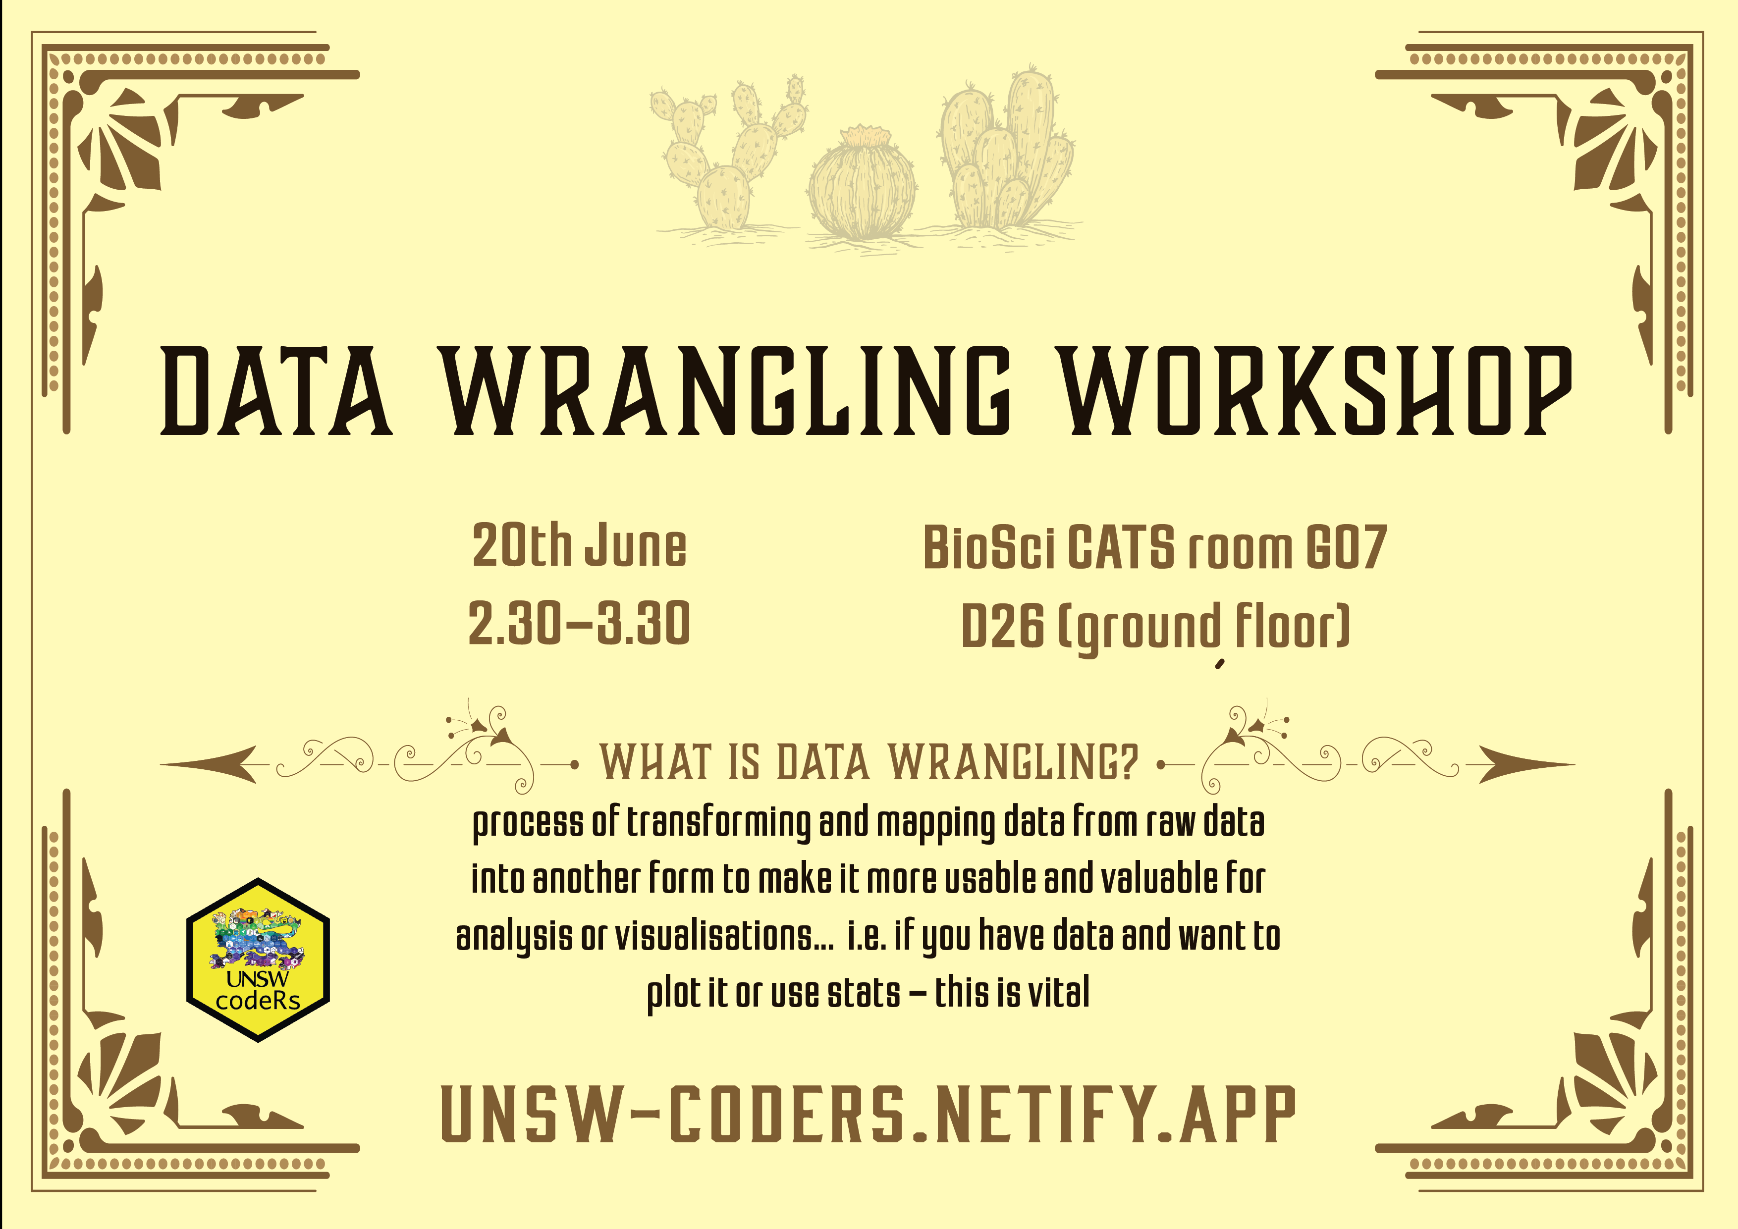

Slide 2
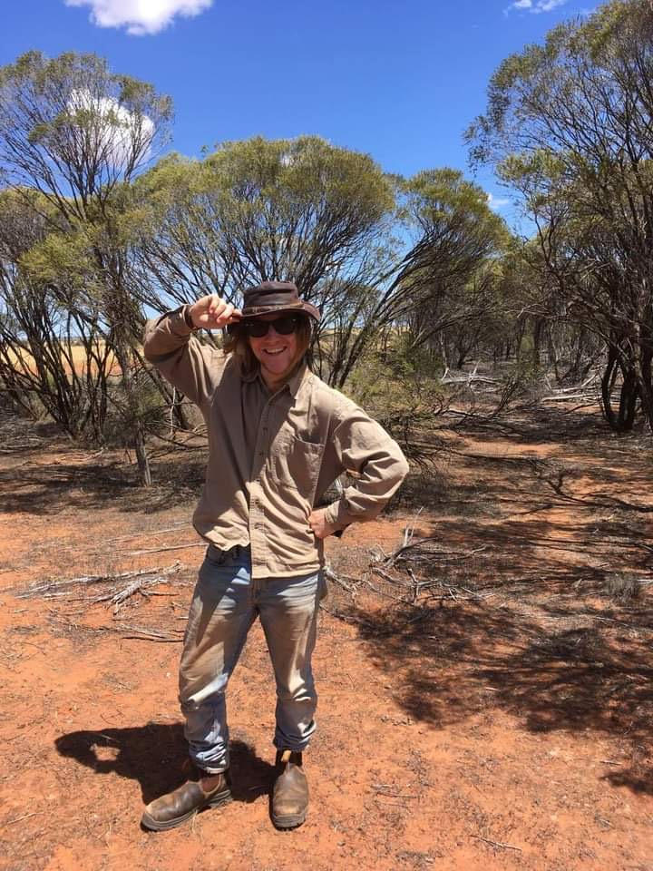
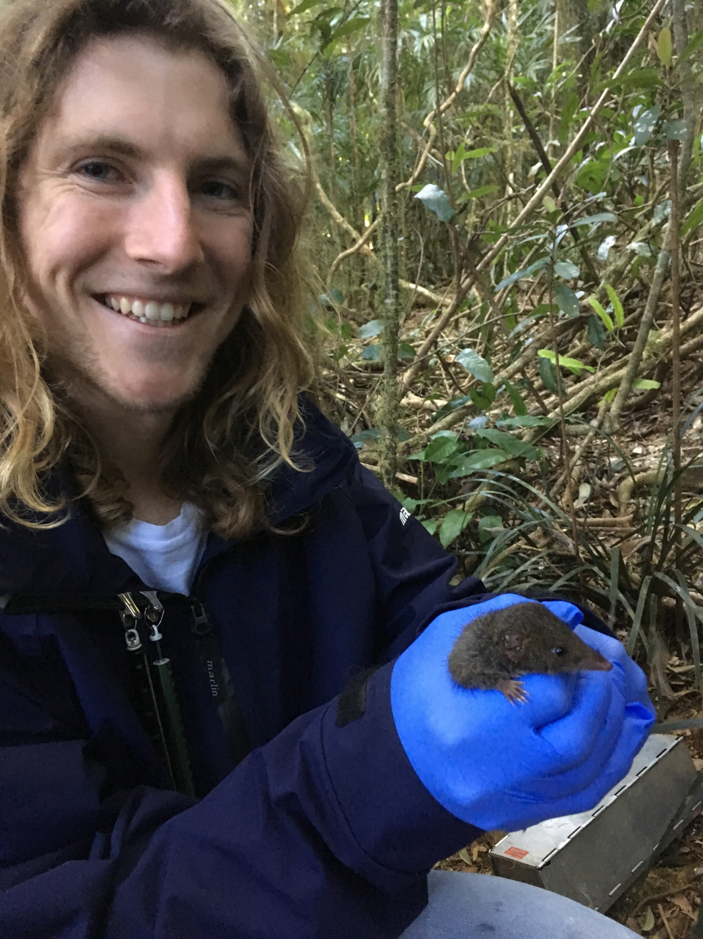
Hons. And PhD at Uni of QLD
Springbrook NP, SE QLD
Wheatbelt, SW West. Aust.

Slide 3
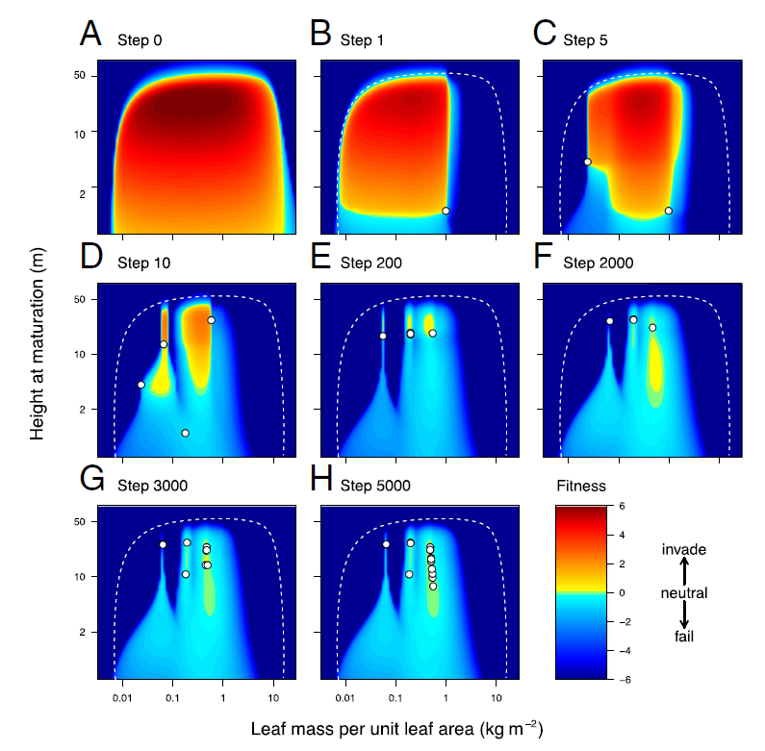
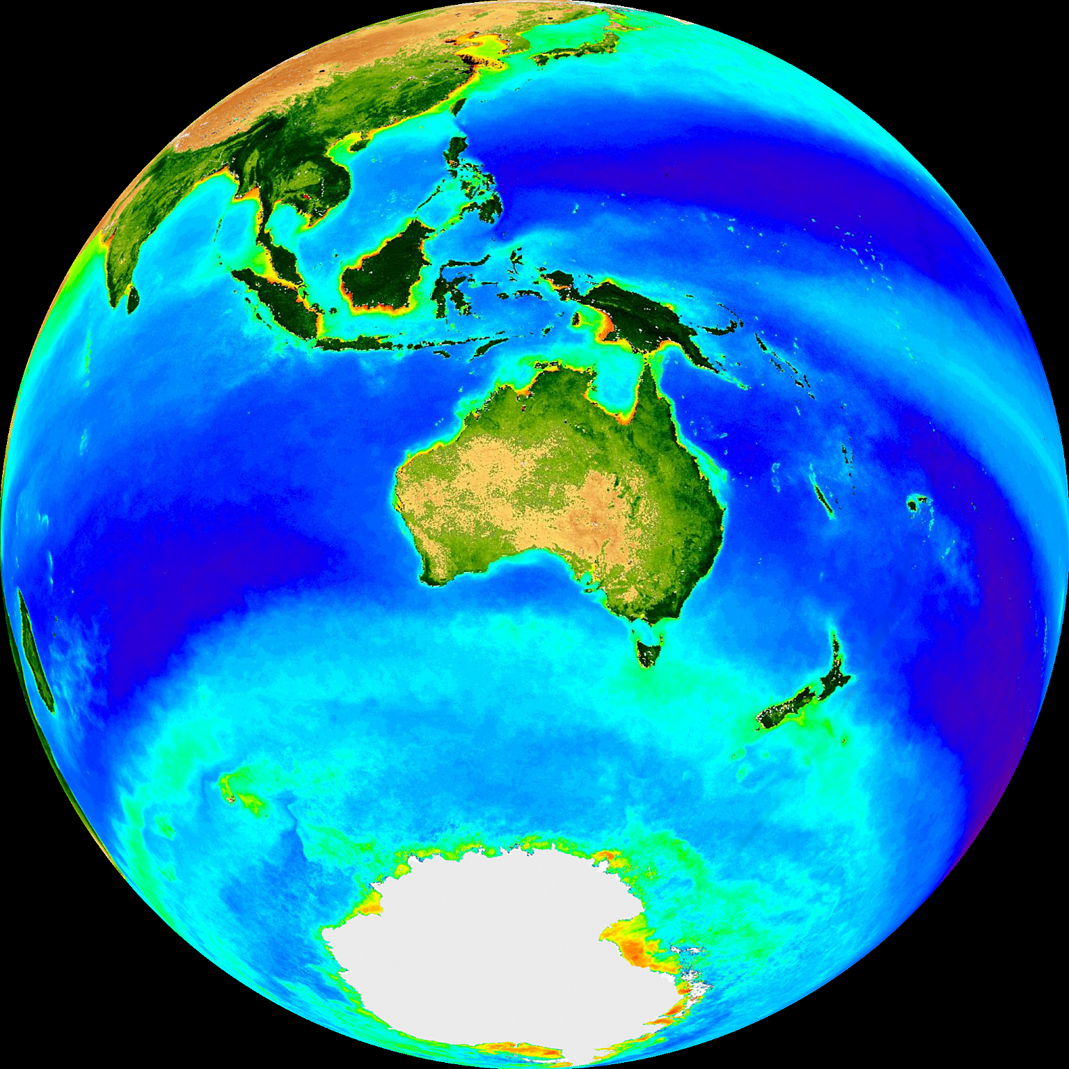



I moved to UNSW to…

Slide 4
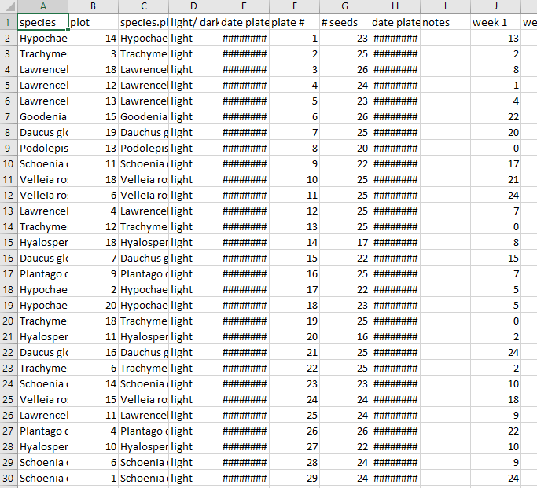
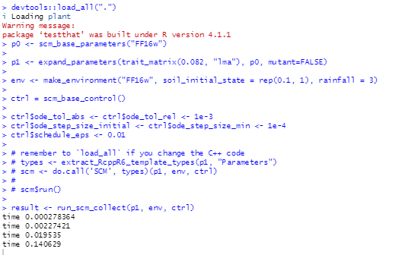
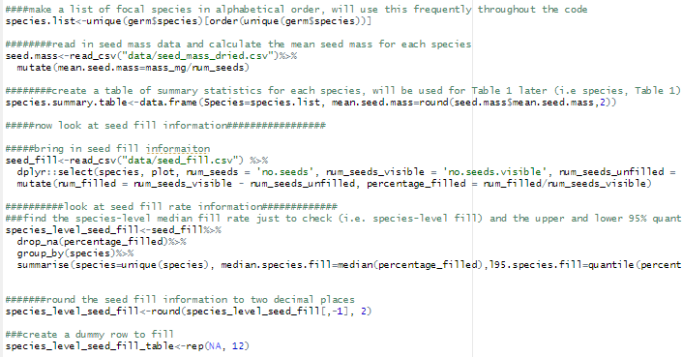
Lots of data wrangling!!

Slide 5
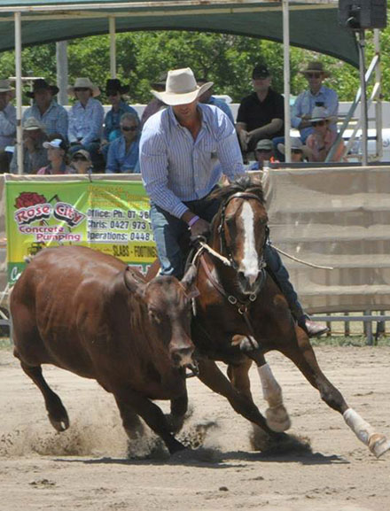
No “one” right way to wrangle
…but there are a couple of helpful principles
Succinct code (i.e. as few commands as possible to achieve goal
Repeatability
Readability
Campdrafting in Warwick
Jane Lee 2013

Slide 6
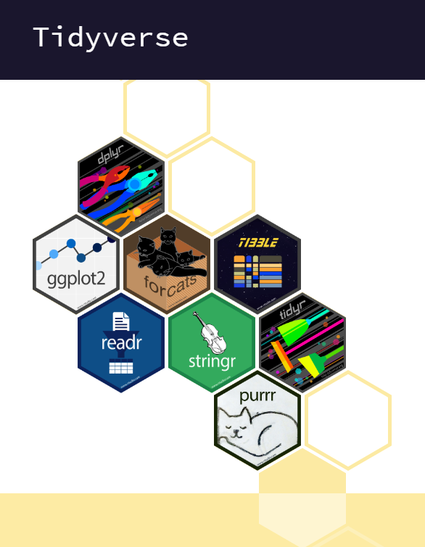
Tidyverse:
A compilation of helpful packages

